Slide 1
Registry Spy OpenEDR

Slide 2



OUR TEAM
Nguyễn Bình Thục Trâm
Võ Anh Kiệt
Nguyễn Bùi
Kim Ngân
20520815
20520605
20520648

Slide 3
Table of contents
01
02
Registry Spy
EDR - OpenEDR

Slide 4
01
Registry Spy

Slide 5

Registry Spy
Registry Spy is a free, open-source cross-platform Windows Registry viewer. It is a fast, modern, and versatile explorer for raw registry files.

Slide 6
Requirement installation
(-) Python >= 3.8
Python is a high-level, general-purpose programming language. Its design philosophy emphasizes code readability with the use of significant indentation via the off-side rule.

Slide 7
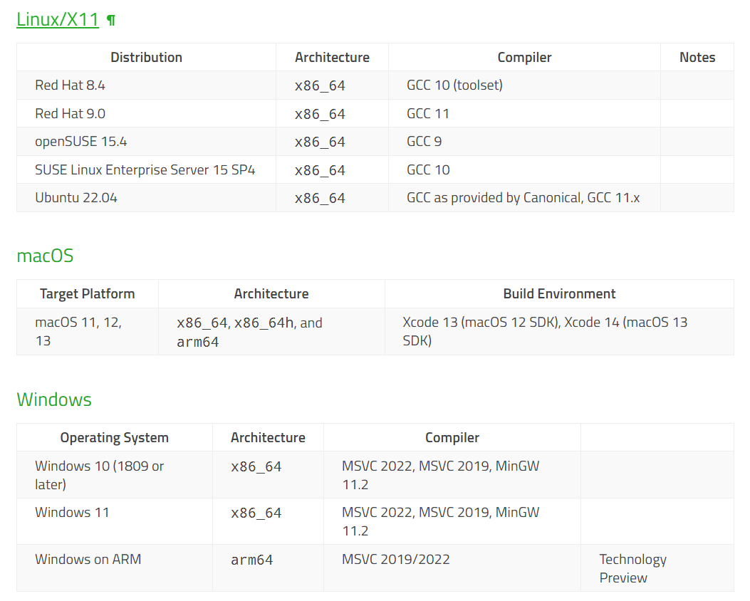
Requirement installation
(-) Operation System

Slide 8
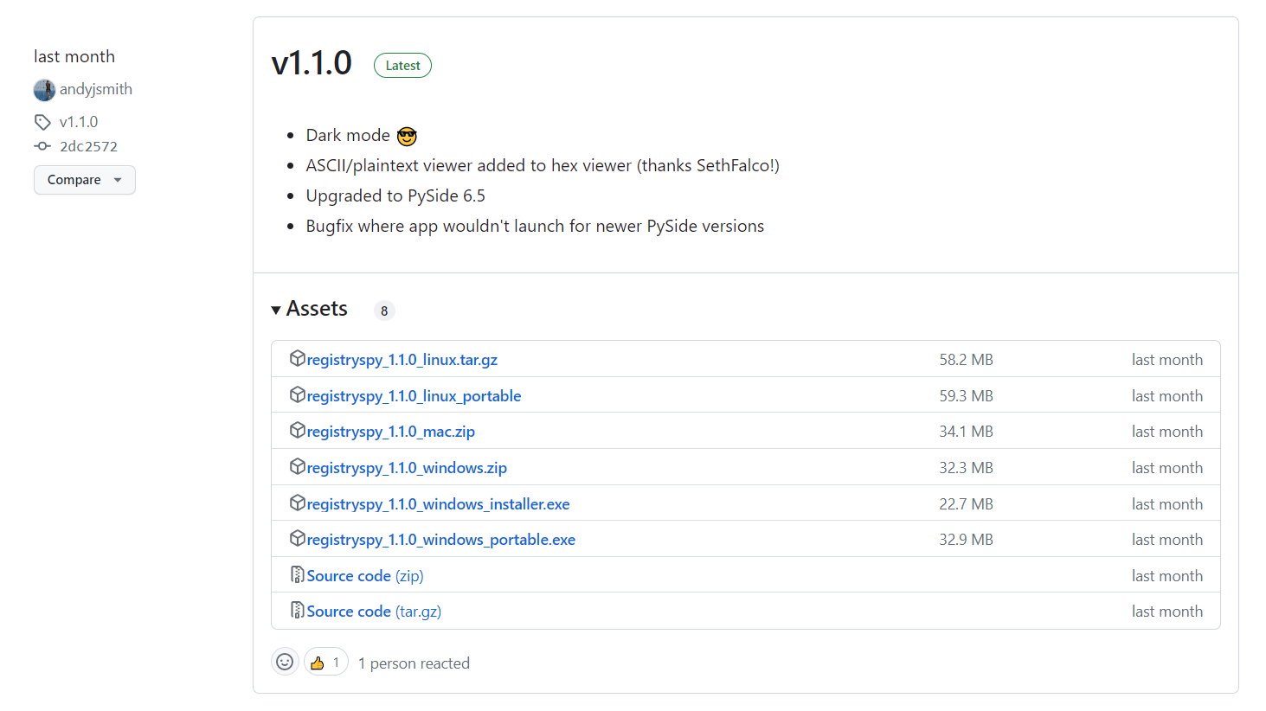
Installation
(-) Version

Slide 9
Installation
(-) Pip pip install registryspy registryspy
(-) Manual pip install –r requirements.txt
python setup.py install registryspy
(-) Standalone pip install –r requirements.txt
python registryspy.py

Slide 10
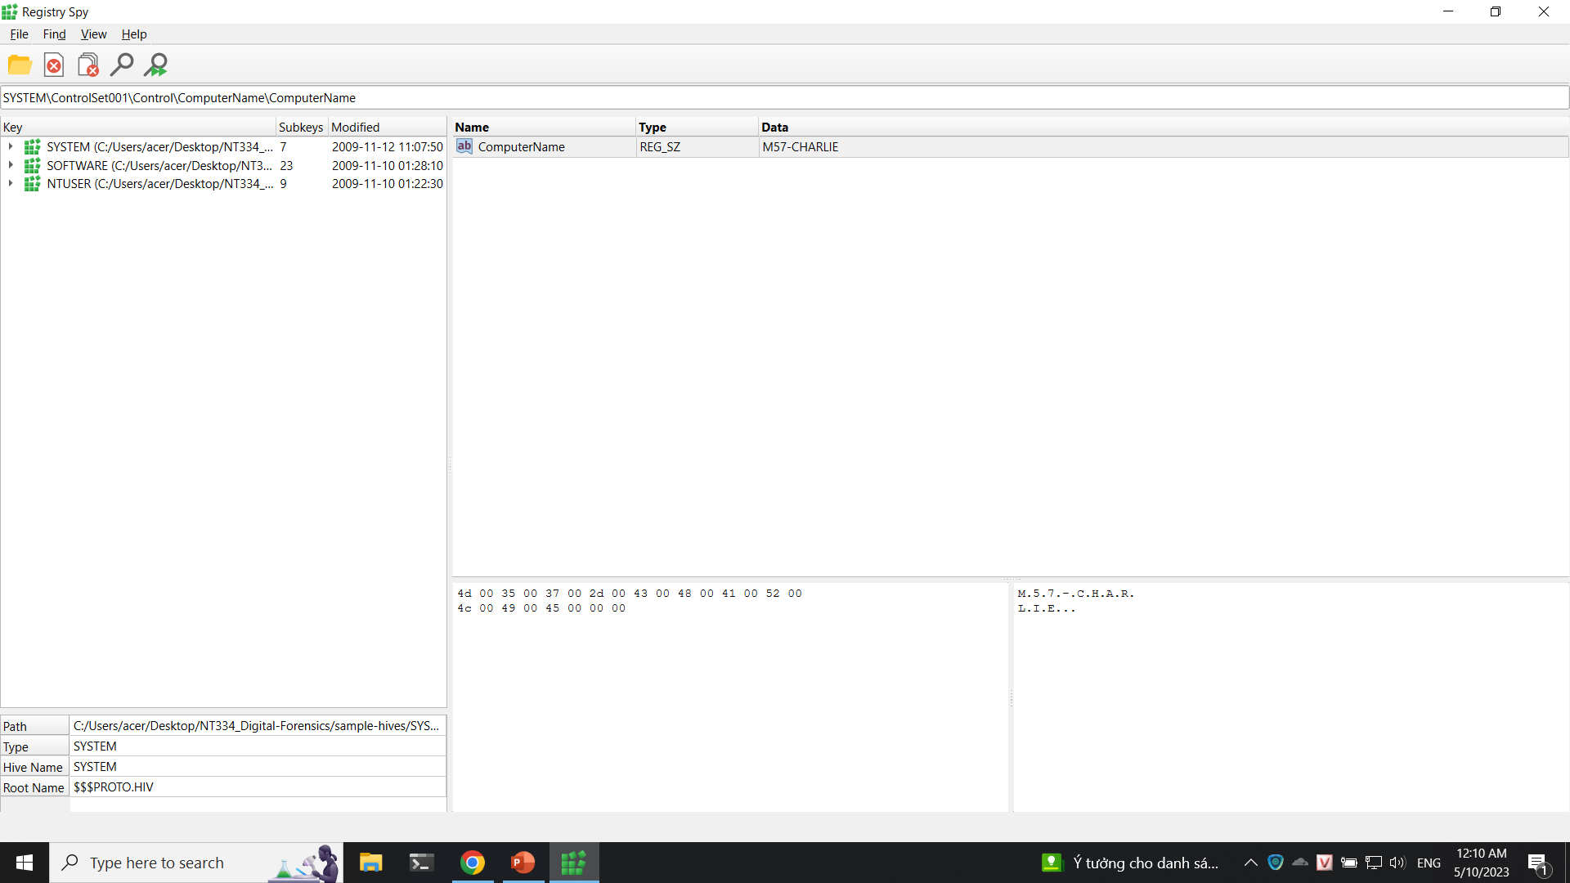
Implemetation

Slide 11
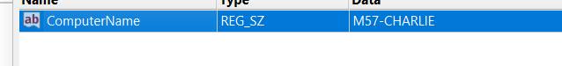
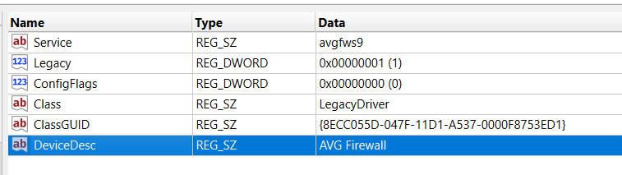
Implemetation

Slide 12
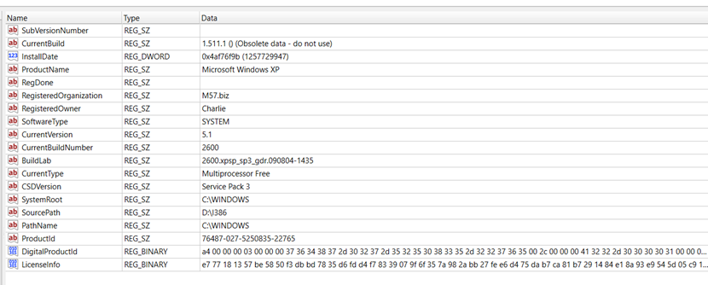
Implemetation

Slide 13
02
EDR – Endpoint Detect Respone OpenEDR

Slide 14

OpenEDR
Open EDR is a sophisticated, free, open-source endpoint detection and response solution. It provides analytic detection with Mitre ATT&CK visibility for event correlation and root cause analysis of adversarial threat activity and behaviors in real time. This world-class endpoint telemetry platform is available to all cyber-security professionals, and every sized organization, to defend against threat actors and cyber criminals.

Slide 15
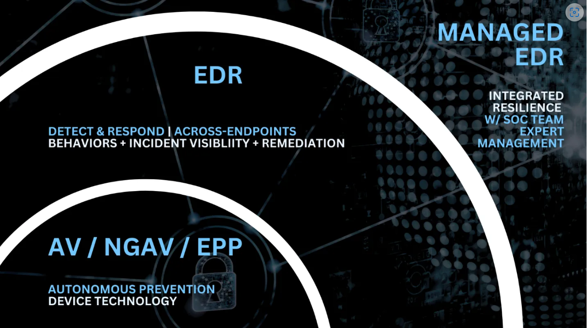
OpenEDR

Slide 16
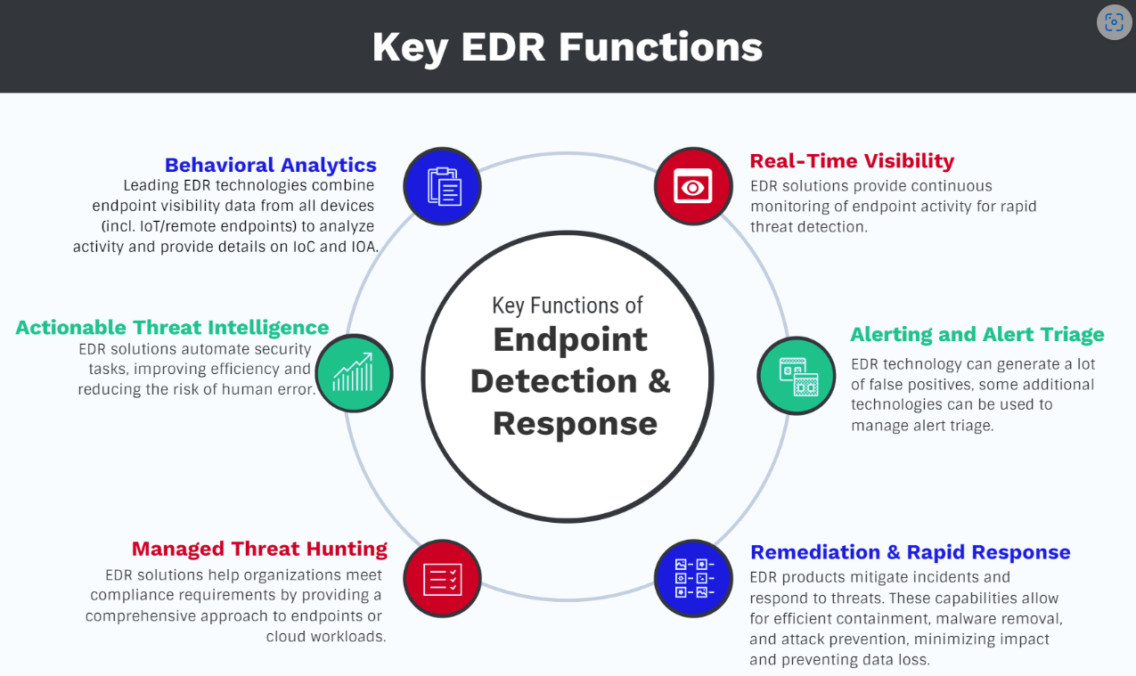
OpenEDR

Slide 17
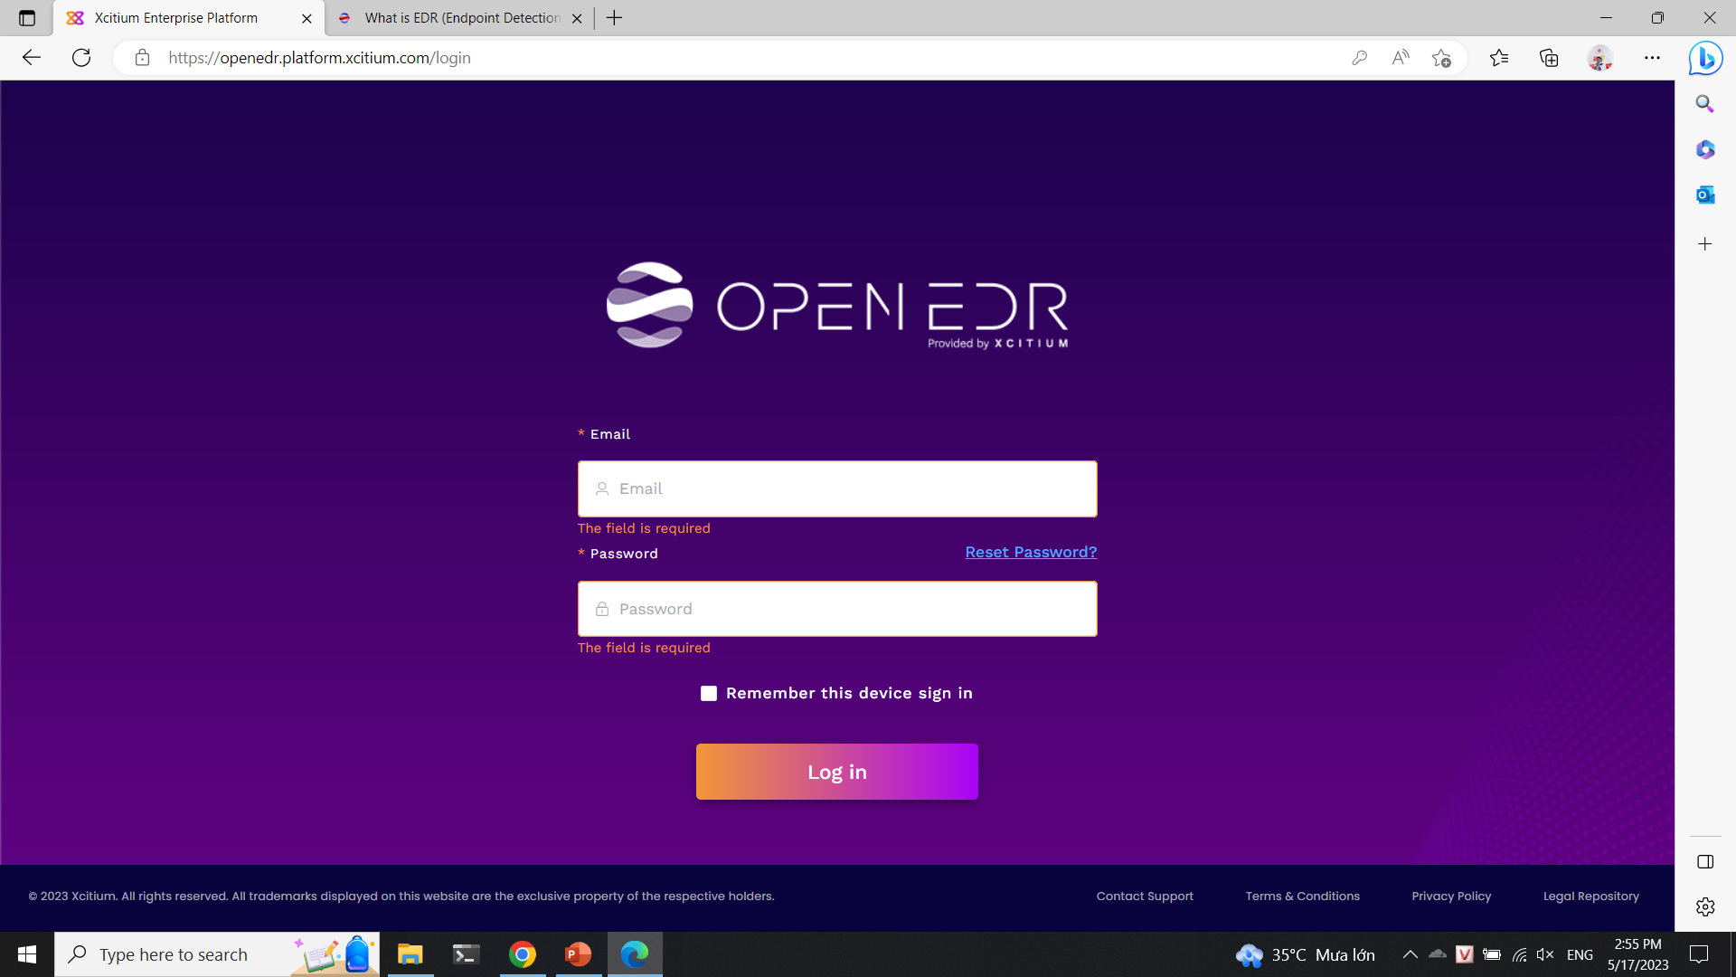
Installation

Slide 18
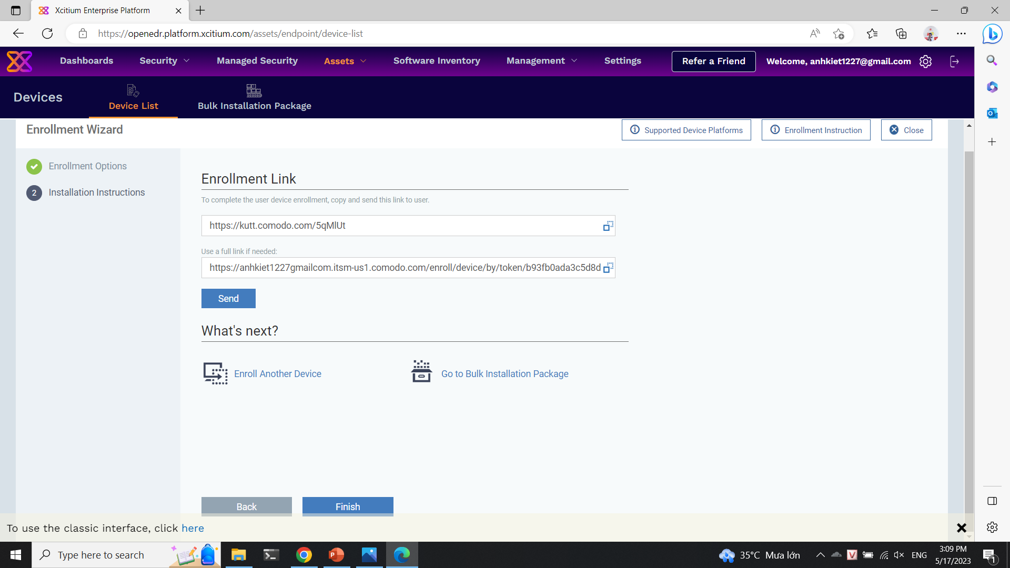
Installation Agent

Slide 19
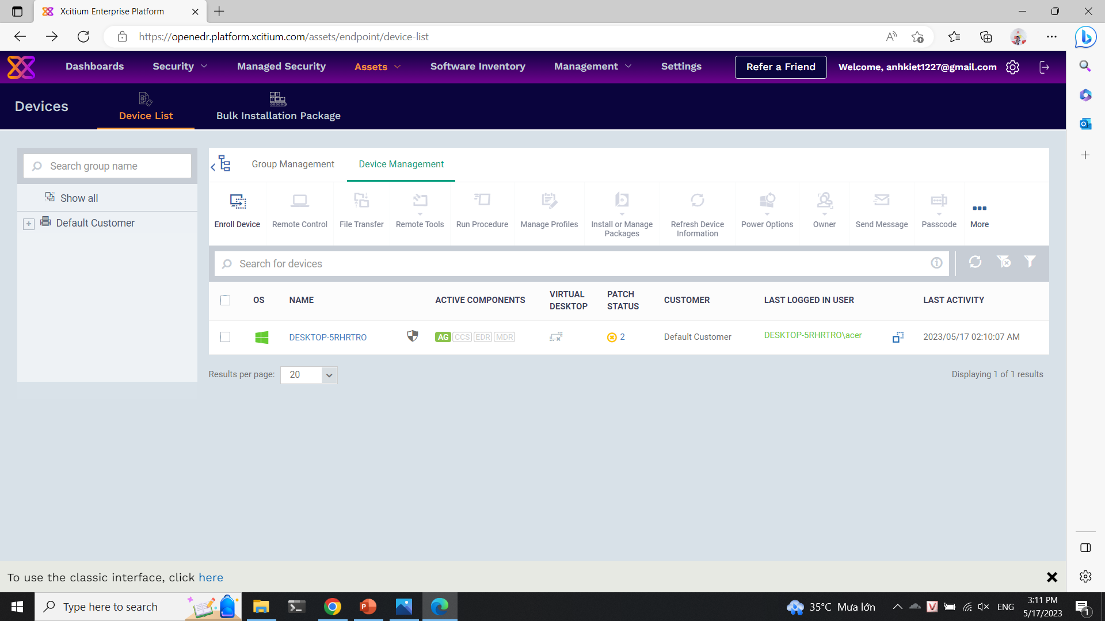
Installation Agent

Slide 20
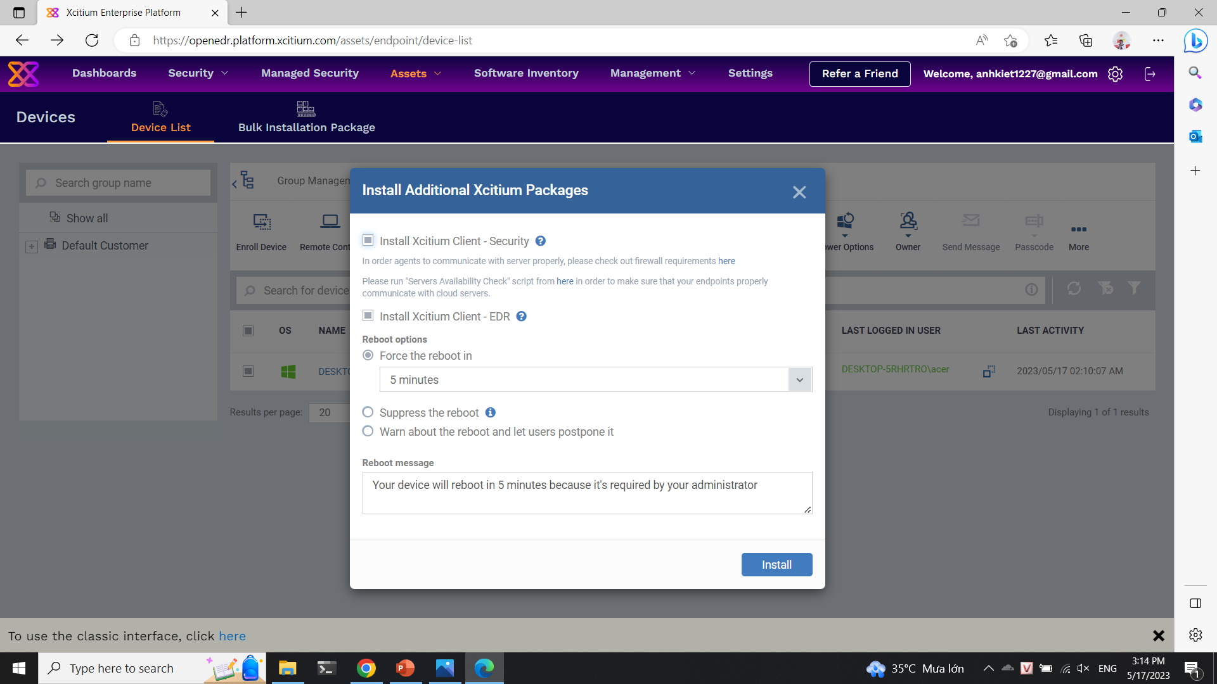
Installation Packages

Slide 21
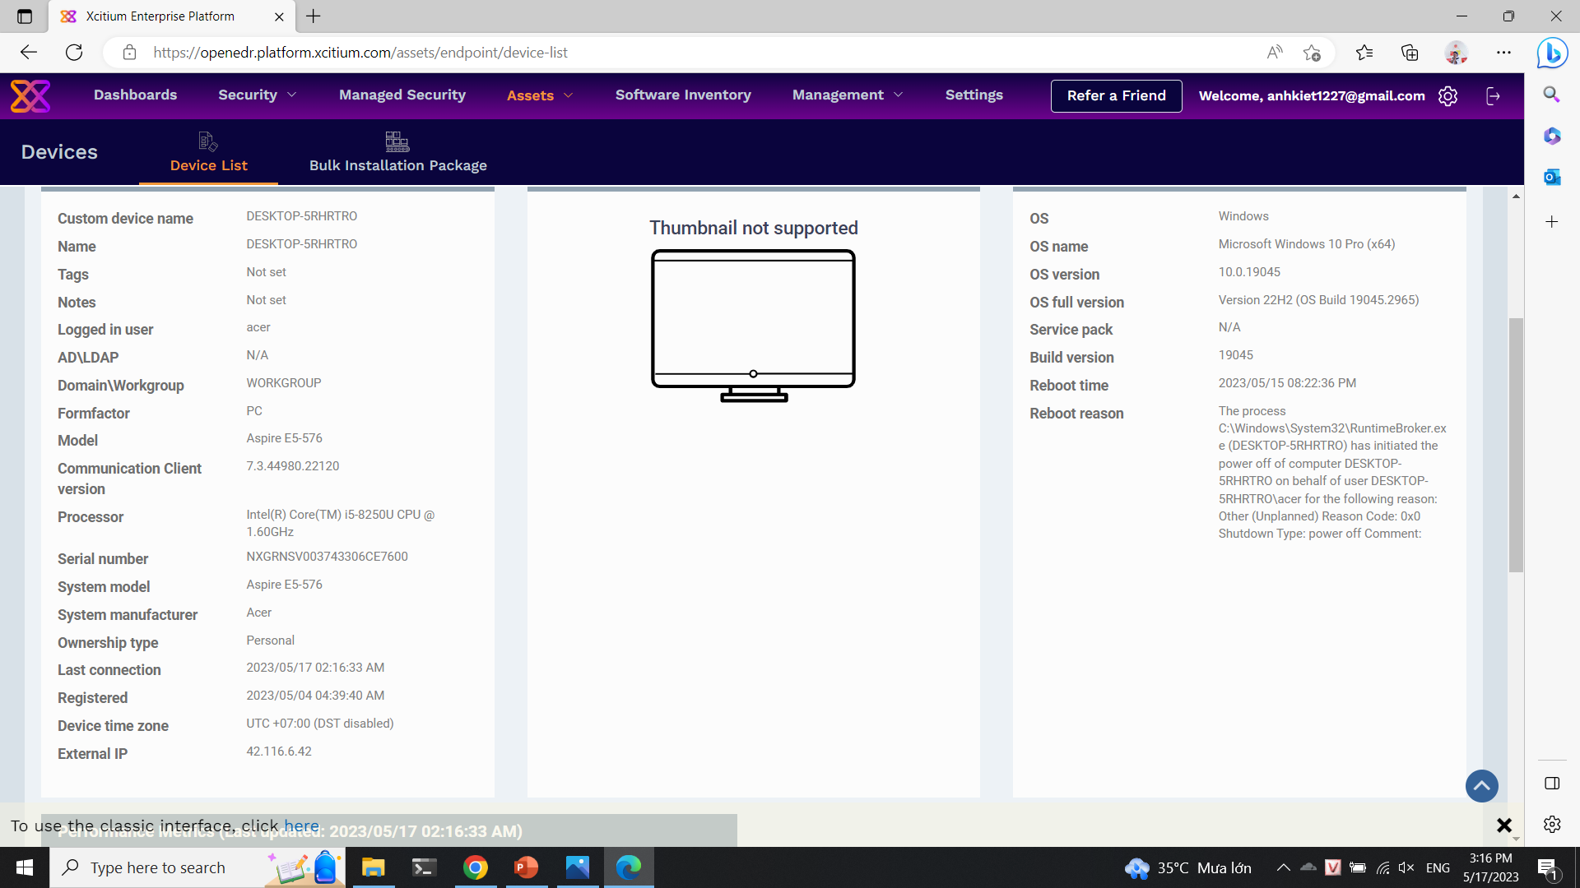
Tool scanning

Slide 22
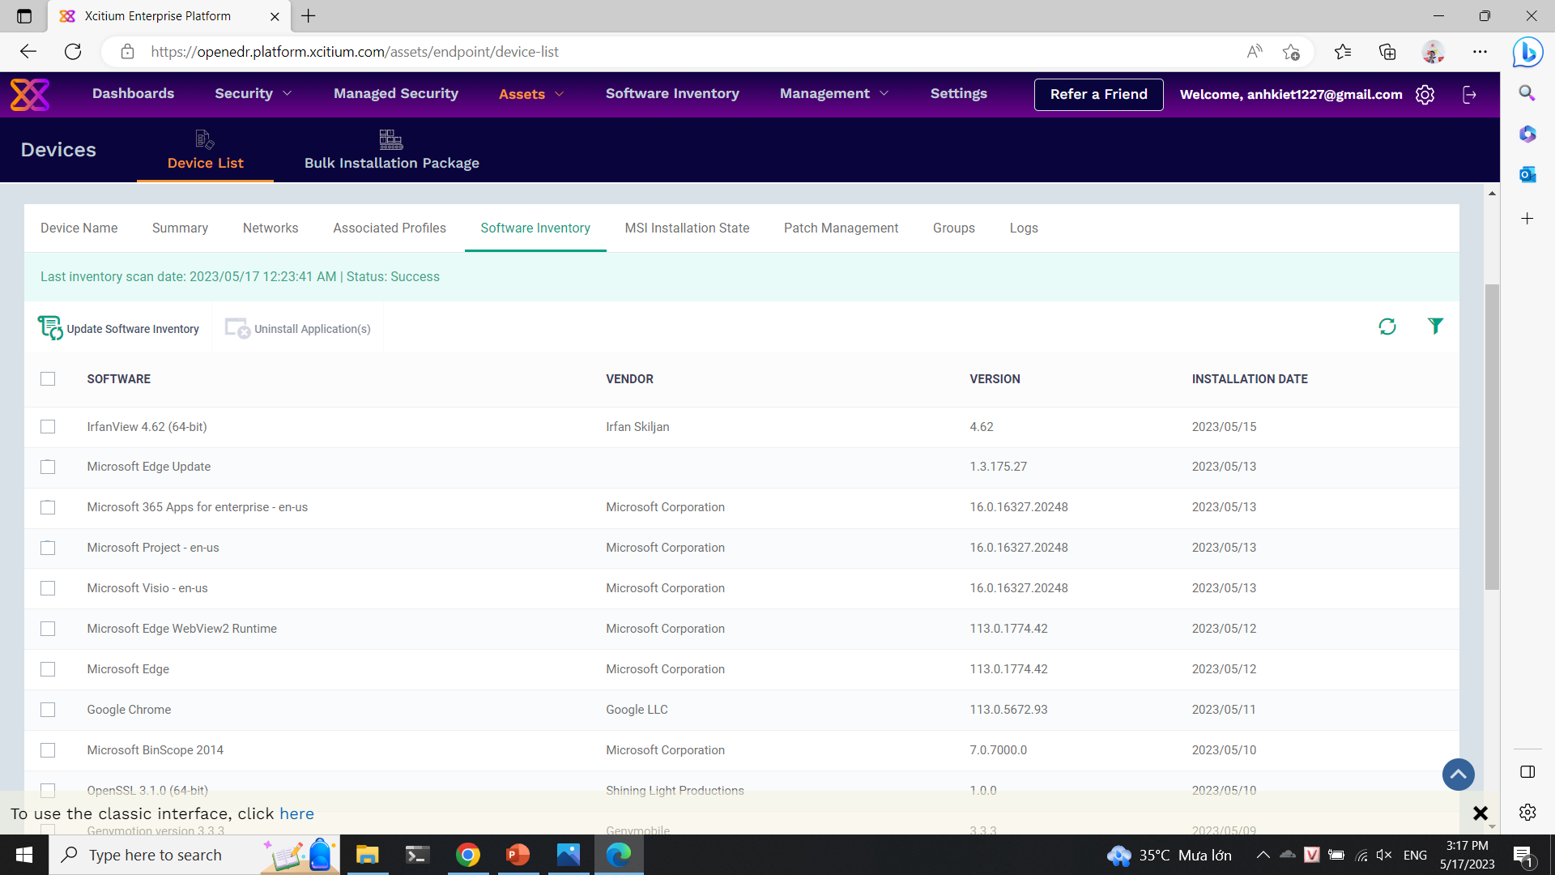
Tool scanning

Slide 23
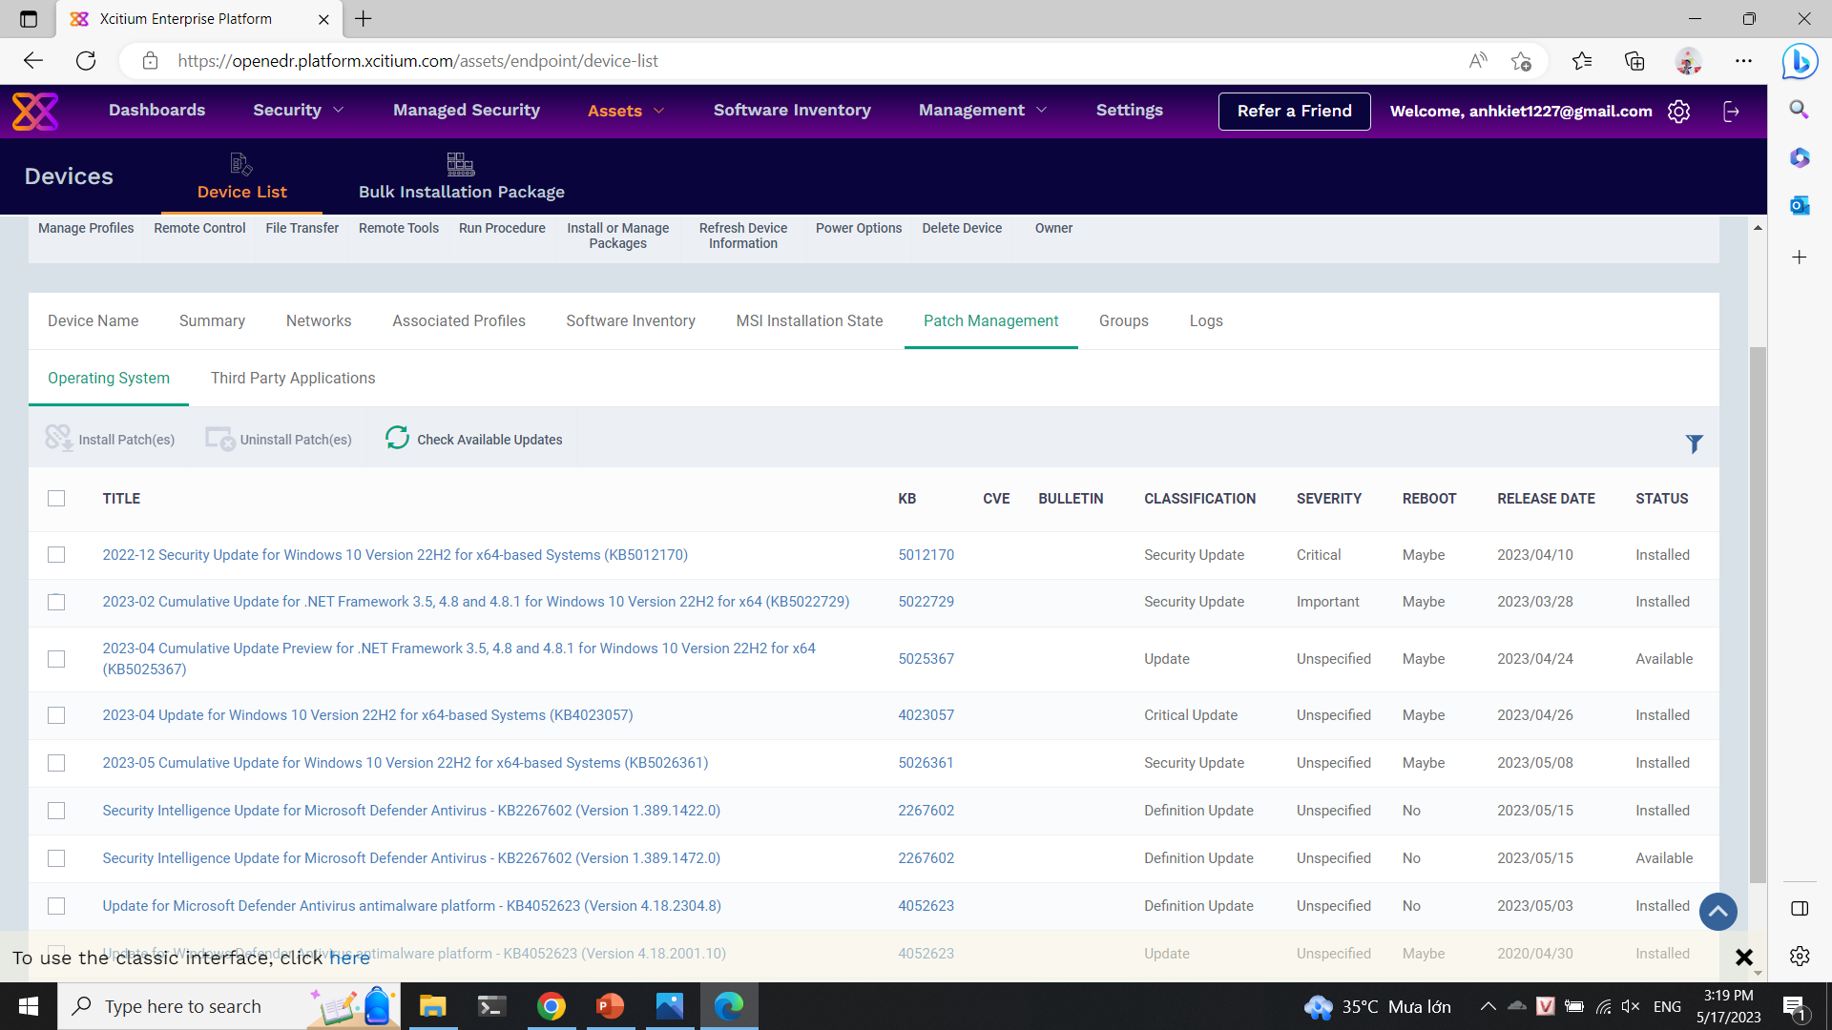
Tool scanning

Slide 24
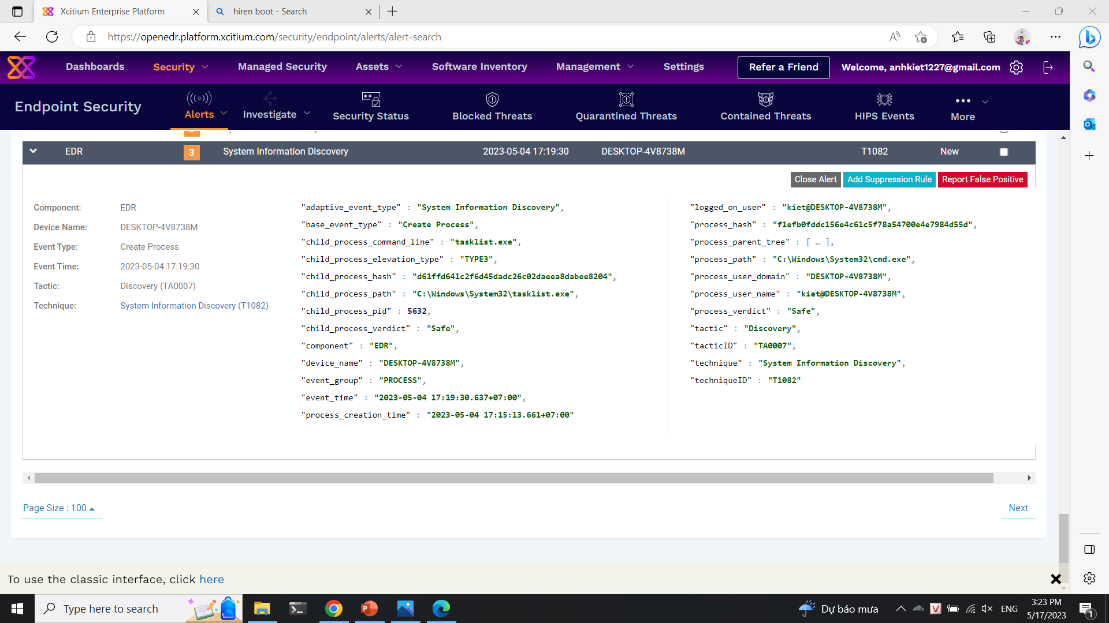
Tool scanning

Slide 25
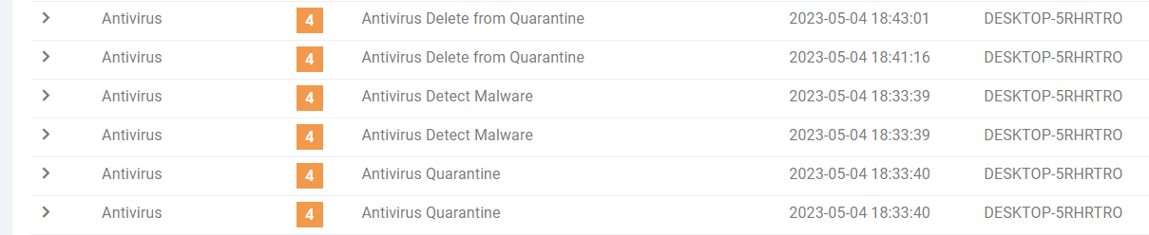
Malware

Slide 26
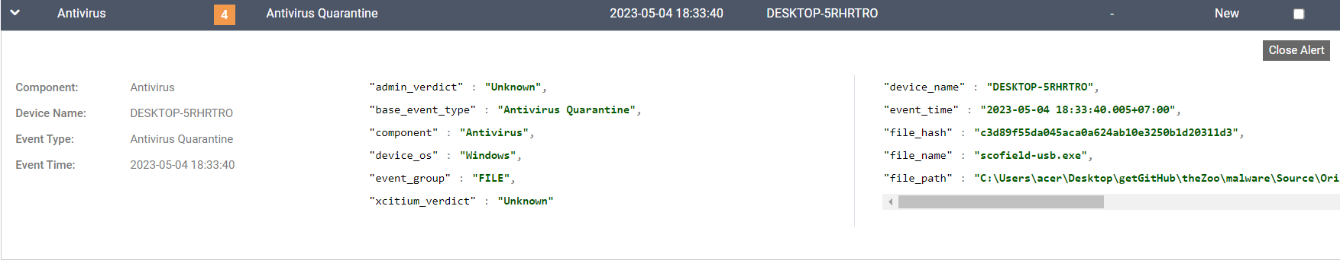
Malware

Slide 27
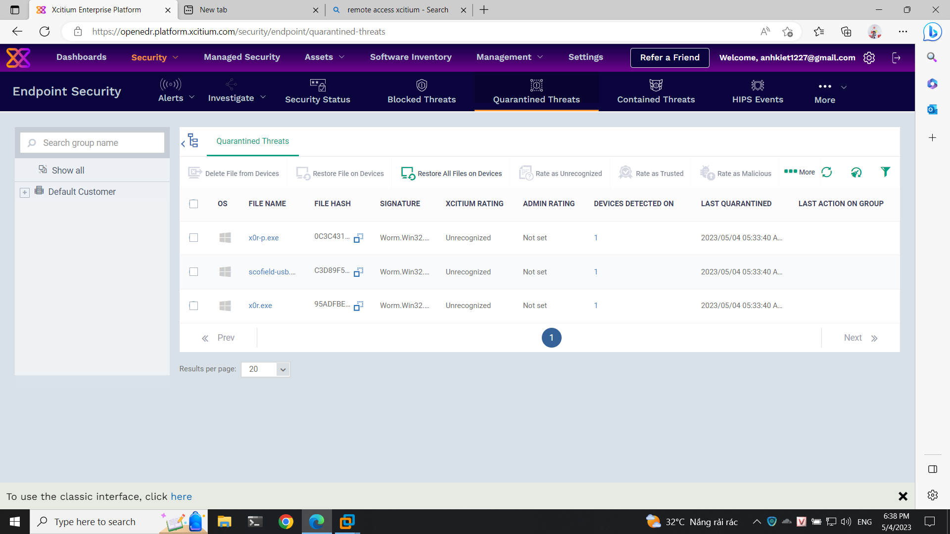
Malware

Slide 28
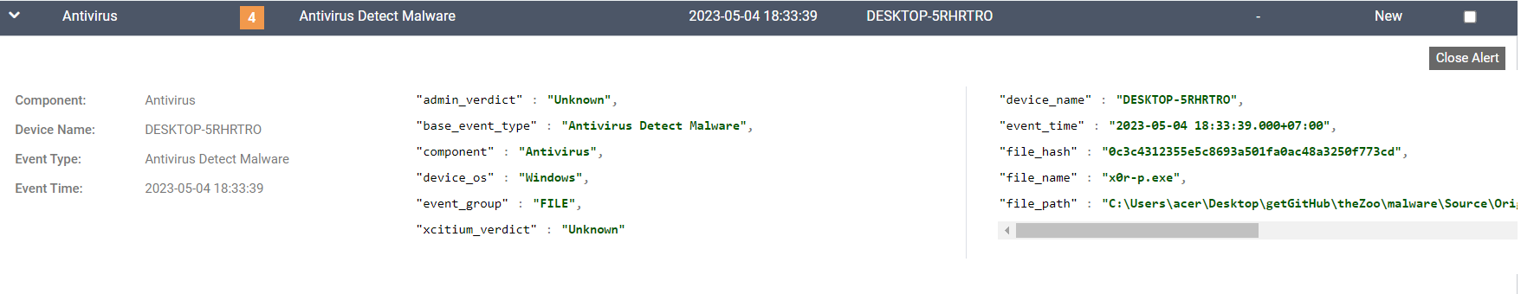
Malware

Slide 29
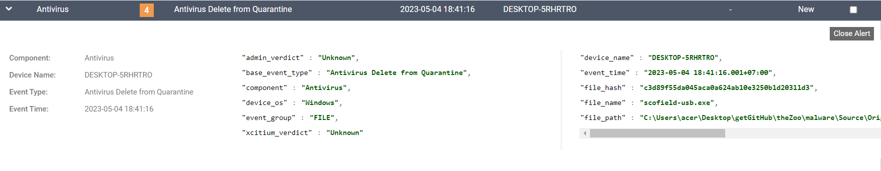
Malware

Slide 30
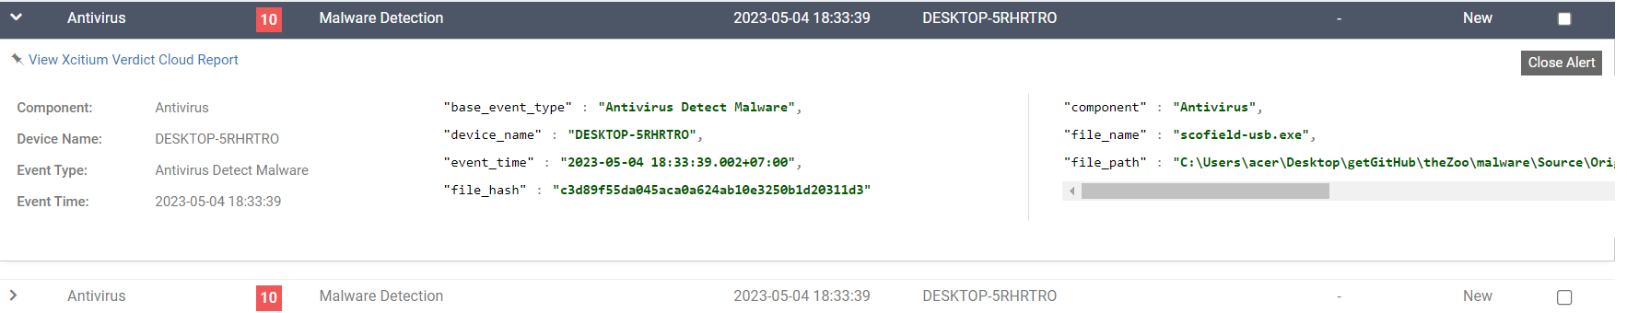
Malware

Slide 31
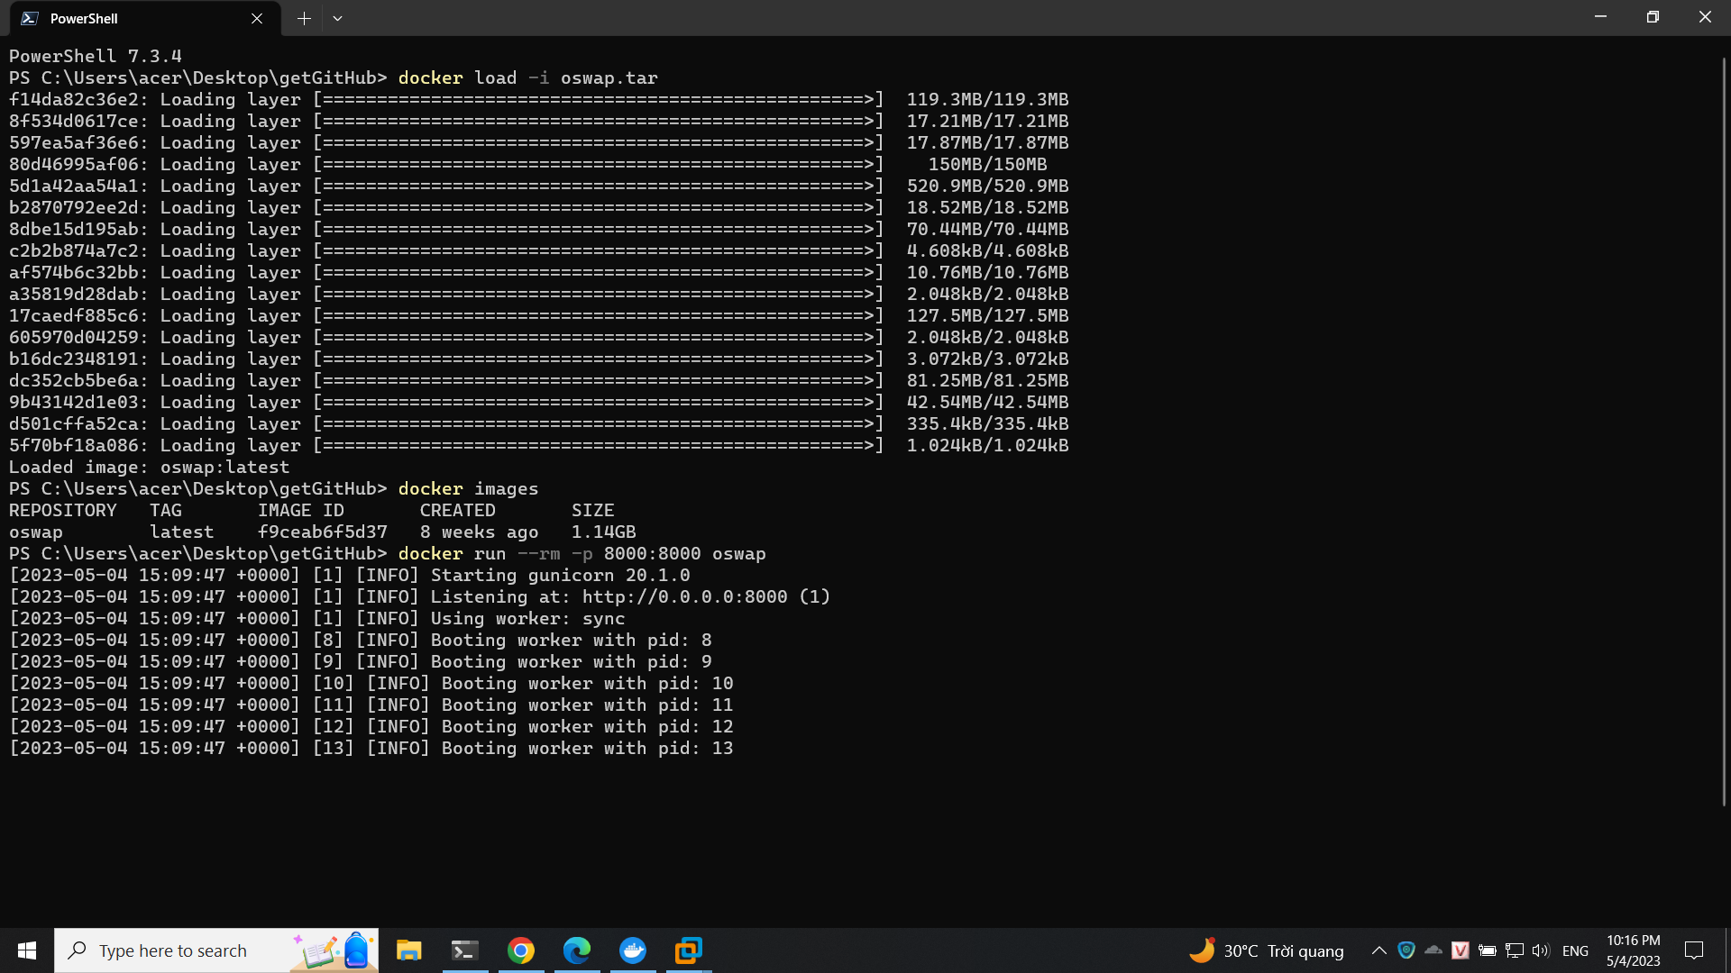
PyGoat – Top 10 OWASP

Slide 32
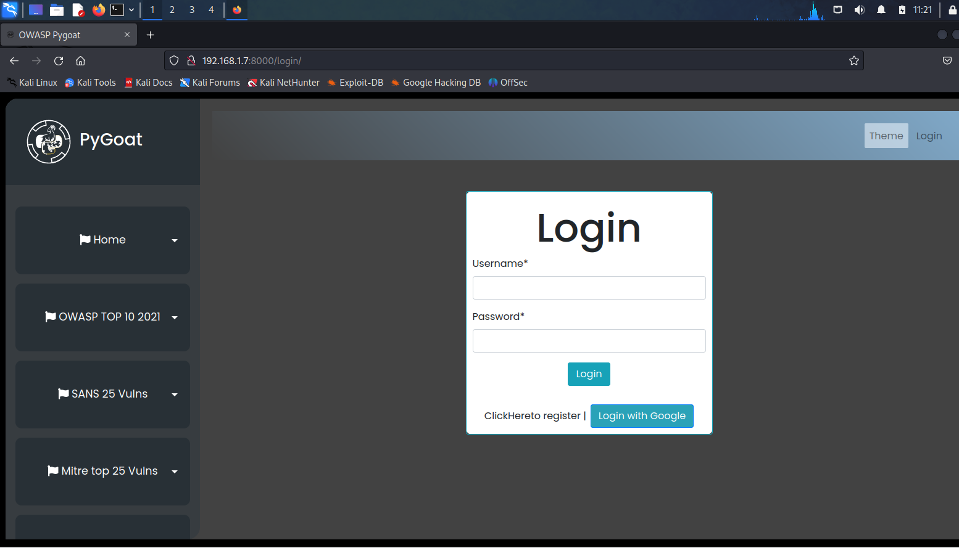
PyGoat – Top 10 OWASP

Slide 33
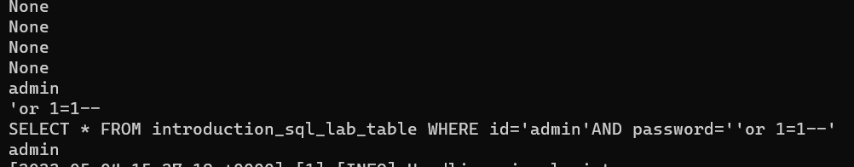
PyGoat – Top 10 OWASP
No announcement on OpenEDR

Slide 34
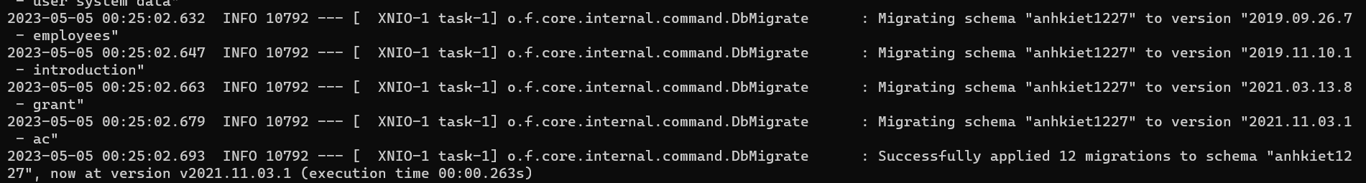
WebGoat – Top 10 OWASP
No announcement on OpenEDR

Slide 35
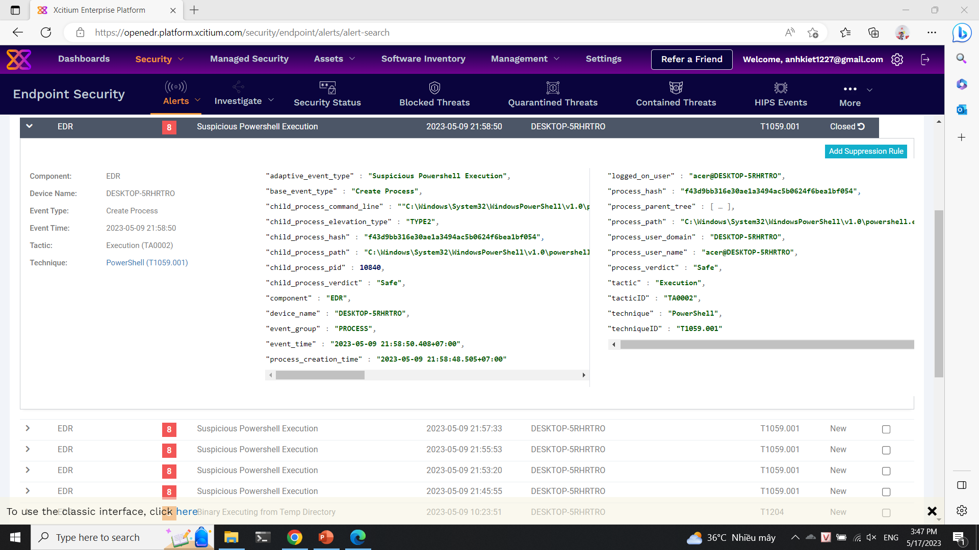
Weakness

Slide 36
Resources
What is EDR (Endpoint Detection & Response)? Open source EDR® (openedr.com)
GitHub - andyjsmith/Registry-Spy: Cross-platform registry browser for raw Windows registry files

Slide 37
Thanks!
Any questions?
Please, keep this slide as attribution

